Slide 1
Spanning Tree based Termination Detection
Aditya Saripalli (20173071)
Issac Balaji (20163051)

Slide 2
Pre-Work
01. Simple Algorithm
02. Rodney Topor's
A token-based algorithm when all children are done terminated parent is terminated.
Color based token which address the issue in simple algo.
03. Chandrasekaran
And Venkatesan’s
04. Arora Gupta's
05. Our Work
Distributed Termination Algorithm using message optimal termination detection
Distributed Termination Algorithm by 2 phases detection and temination
Used Rodney Topor's algo with our change in algo.

Slide 3
Assumptions
Minimum spanning tree (path) is known
Nodes are available and not modified.
No new channels (other than the edges of the MST) are established.

Slide 4
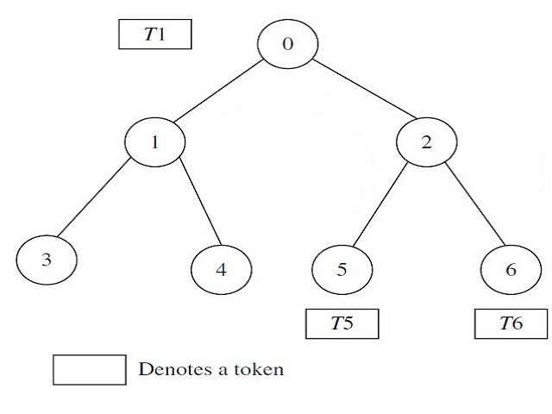
Simple Algorithm
N processes P_{i} , 0 ≤ i ≤N, which are modeled as the nodes i
edges of the graph represent the communication channels.
Children report to their parents, if they have terminated.
parent node will similarly report to its parent when it has completed processing and all of its immediate children have terminated
Algorithm terminated when root terminates.

Slide 5
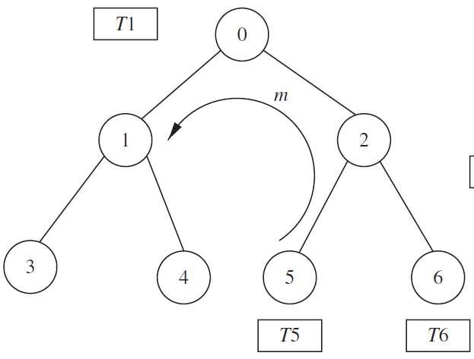

Problem with the algorithm: The algorithm fails when a process (after it has sent a token to its parent), receives a message from some other process.

Slide 6
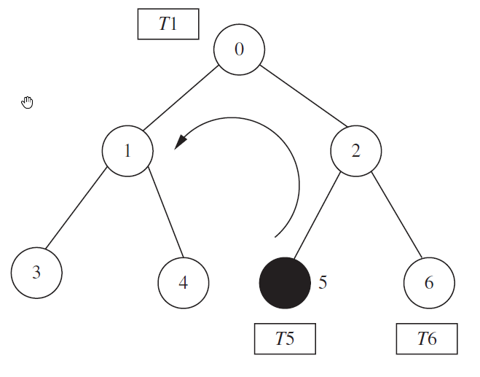
Rodney.W.Topor’s
Initially color all the processes and tokens as WHITE.
A process turns BLACK when it sends a message to some other process. It turns WHITE, after it has sent the BLACK token to its parent.
Upon receiving a BLACK token (from one of the child(s)) Root will send a REPEAT signal to all its children propagating till leaf node.
The leaf nodes then restart the algorithm on receiving the REPEAT signal.
Root node concludes that termination detection is complete only on receiving WHITE tokens from all the child nodes.

Slide 7
Performance
Best case Message Complexity O(N)
One Round
Worst case Message Complexity O(N*M)
M – no of computation messages exchanged on black token
Best case - when the token needs to be sent to its parent so N nodes will lead to O(N) complexity.
Worst case - if it takes M no of rounds of tokens passing. Then M times N nodes must communicate and marks for complexity O(N * M).

Slide 8
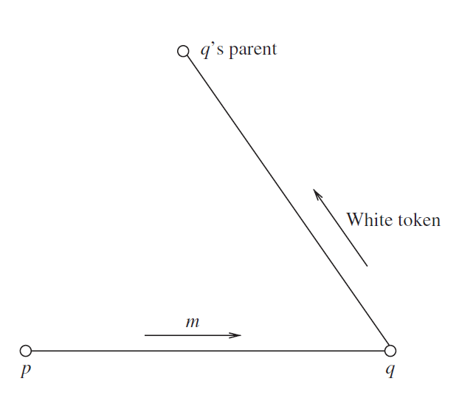
S.Chandrasekaran And S.Venkatesan’s
An extension of Rodney.W.Topor.
When a node p sends a message m to node q, p should wait until q becomes idle.
When the node q terminates, it sends an acknowledgement (a CONTROL message) to node p informing node p
Both the sender and the receiver keep track of each message exchange.
All nodes will only send WHITE token.
A message optimal way of termination detection.

Slide 9
Performance
Topor’s model
Message Optimal
Worse Case Message Complexity O(N*M)
the total number of messages generated by the algorithm is 2* |E| + |V| − 1 + M.
E edges – links / warning messages
M remove message
V nodes
Message Complexity O(|E| + M)
as |E| > |V|

Slide 10
R.K.Arora and M.N.Gupta’s

Slide 11
R.K.Arora and M.N.Gupta’s
The detection-message is issued only when the process and all its communicating neighbors become PASSIVE.
The detection message wave once issued by the root process first spreads downwards and then contracts upwards.
No additional effort is required to maintain the local information in the control section of a process.

Slide 12
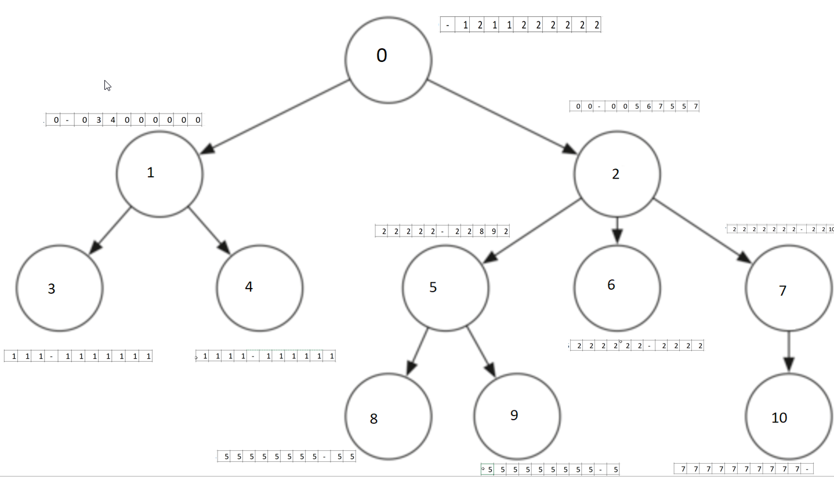
Our Model
We have used Rodney.W.Topor’s model for termination detection.
In addition to it, we have added an algorithm for computing a routing array for message passing.
Messages are sent only along the edges of the nodes using the routing path mentioned in the array.

Slide 13
Comparision
Rodney.W.Topor
Message Optimal
Our model
Simple
More messages
Frequent Repeats
Complete env repeats for even one black token
Less message overheads and message traffic
Mostly waiting for other nodes to go to idle.
In Arora’s method even waiting for neighborhood nodes to become passive
Comparatively Simple after initialization.

Slide 14
Rodney Topor - A Deep Dive (Design & Implementation)

Slide 15
Design
Graph.h/cpp
Node.h/cpp
Input Data
TerminationDetection.h/cpp
run_td.py
main.cpp
OpenMPI

Slide 16
Implementation
For “N” nodes we create (N+1) OpenMPI processes.
Process with Rank=0 will be a master/manager process.
Processes with ranks 1 to N will represent N nodes of the MST.
As naming convention, we call master/manager process as MASTER and others as WORKER processes respectively.
In OpenMPI, we only use MPI_COMM_WORLD communicator for blocking send and receive communications between processes.
Messages supported : MSG_CONFIG, MSG_DONE, MSG_KILL, MSG_COMPUTE, MSG_REPEAT, MSG_TOKEN.
Types of nodes : RootNode, InternalNode, LeafNode

Slide 17
Implementation (contd..)
Type of Process | Type of Node (in the MST) | Messages involved in …
 |  | Sending | Receiving
MASTER | -- | MSG_CONFIG, MSG_KILL | MSG_DONE
WORKER | RootNode | MSG_REPEAT, MSG_COMPUTE, MSG_DONE | MSG_CONFIG, MSG_KILL, MSG_COMPUTE, MSG_TOKEN
 | InternalNode | MSG_REPEAT, MSG_COMPUTE, MSG_TOKEN | MSG_CONFIG, MSG_KILL, MSG_REPEAT, MSG_COMPUTE, MSG_TOKEN
 | LeafNode | MSG_TOKEN, MSG_COMPUTE | MSG_CONFIG, MSG_KILL, MSG_REPEAT, MSG_COMPUTE

Slide 18
Message passing between nodes/processes
MASTER
MSG_KILL
MSG_DONE
MSG_KILL
MSG_KILL
MSG_CONFIG
MSG_CONFIG
MSG_CONFIG
MSG_REPEAT
MSG_REPEAT
Root
Node
MSG_COMPUTE
Internal
Node(s)
MSG_COMPUTE
Leaf
Node(s)
MSG_TOKEN
MSG_TOKEN
WORKERS

Slide 19
MASTER
Reads the input data file containing the graph.
Instantiate a Graph object and saved the input graph in it, for further computations.
Runs Kruskal's algorithm with a Union-Find data structure to compute the MST as an adjacency list.
From the adjacency list identify the list of child nodes for each node in the spanning tree.
Compute the routing table for the MST for nodes to send messages among themselves.
For each node in the MST send the RootNode, ChildNodes and Routing Array, specific to that node/process only.
Generate a random compute message, with a source & destination selected randomly, and send it to the source node WORKER process.
Wait for the MSG_DONE message from the RootNode indicating the termination detection algorithm is completed.
Send a KILL message to all the WORKER processes to terminate them gracefully.

Slide 20
WORKER
Instantiate a Node object.
Receive all the MSG_CONFIG messages from the MASTER & store them in the Node object.
If the current WORKER process rank matches the COMPUTE message source node, then the compute message is saved, otherwise discarded.
The WORKER node then start executing a computations loop (which would randomly take any time between 1 to 5 seconds).
During the computations, the node will check if it has any saved compute message.
If its there, then it sends the messages using the routing array, and mark its token color as BLACK. Now it is a BLACK process.
All the leaf WORKER nodes will start the termination detection by sending MSG_TOKEN to their parent node, after their respective computations are done.
All the internal nodes will wait until they have received MSG_TOKEN messages from all their child nodes.

Slide 21
WORKER (contd..)
Once received if there is a BLACK token among them, then forward the same to the parent node. Otherwise, send a WHITE token to the parent node.
A BLACK process, after sending it BLACK token to the parent node, will mark its token as WHITE.
The Root WORKER node will wait for the tokens from all the child nodes.
Once received if there is a BLACK token in them, then it will initiate a REPEAT signal to all the child nodes.
Once this REPEAT signal reaches the leaf node, the leaf node will re-initiate termination detection algorithm again.
After the Root node has received all the WHITE tokens from all its child nodes, it will send a MSG_DONE message to the MASTER process.
Once the message MSG_KILL is received – stop and exit the WORKER process.

Slide 22
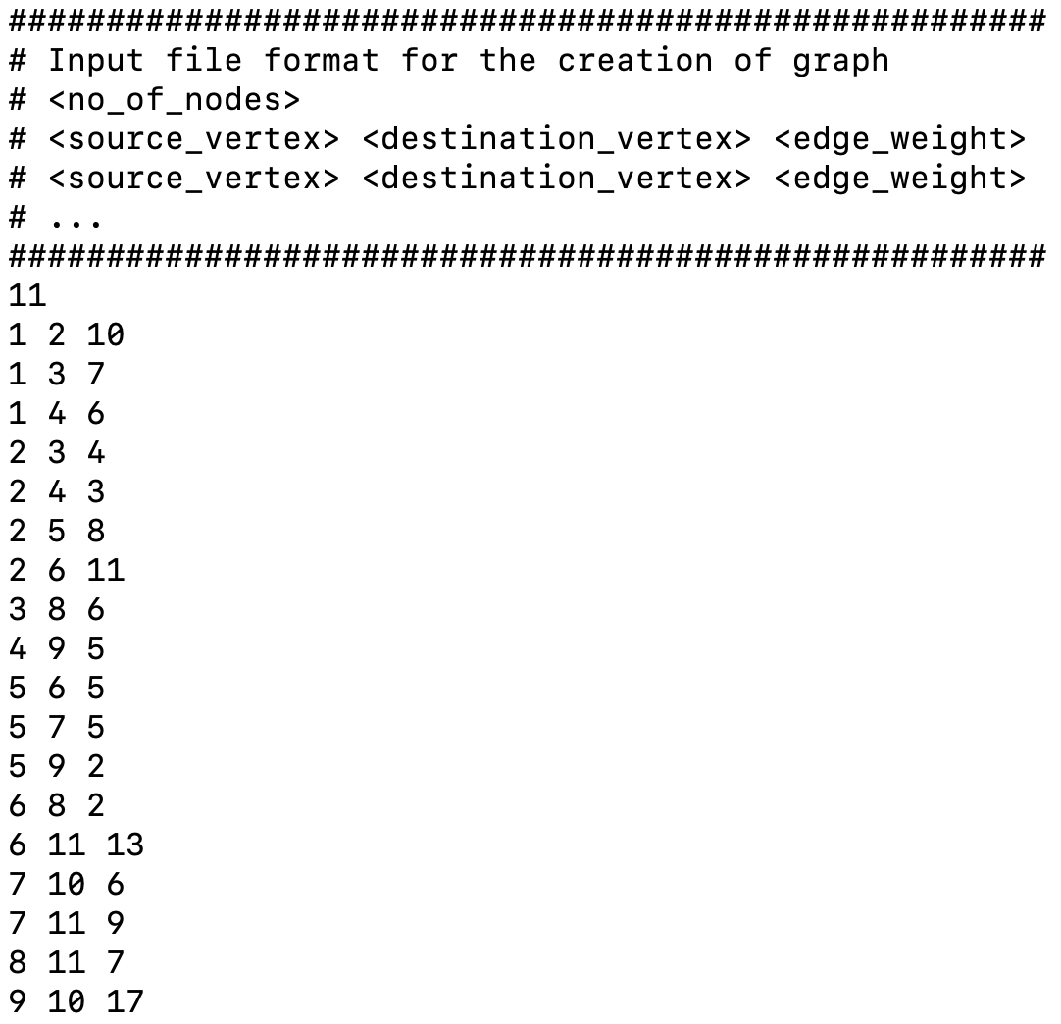
Sample Input Data

Slide 23
Sample Routing Table
 | 1 | 2 | 3 | 4 | 5 | 6 | 7 | 8 | 9 | 10 | 11
1 | -1 | 4 | 4 | 4 | 4 | 4 | 4 | 4 | 4 | 4 | 4
2 | 4 | -1 | 3 | 4 | 4 | 4 | 4 | 4 | 4 | 4 | 4
3 | 2 | 2 | -1 | 2 | 2 | 2 | 2 | 2 | 2 | 2 | 2
4 | 1 | 2 | 2 | -1 | 9 | 9 | 9 | 9 | 9 | 9 | 9
5 | 9 | 9 | 9 | 9 | -1 | 6 | 7 | 6 | 9 | 7 | 6
6 | 5 | 5 | 5 | 5 | 5 | -1 | 5 | 8 | 5 | 5 | 8
7 | 5 | 5 | 5 | 5 | 5 | 5 | -1 | 5 | 5 | 10 | 5
8 | 6 | 6 | 6 | 6 | 6 | 6 | 6 | -1 | 6 | 6 | 11
9 | 4 | 4 | 4 | 4 | 5 | 5 | 5 | 5 | -1 | 5 | 5
10 | 7 | 7 | 7 | 7 | 7 | 7 | 7 | 7 | 7 | -1 | 7
11 | 8 | 8 | 8 | 8 | 8 | 8 | 8 | 8 | 8 | 8 | -1
Sample path from : Node[11] --------> Node[2]

Slide 24
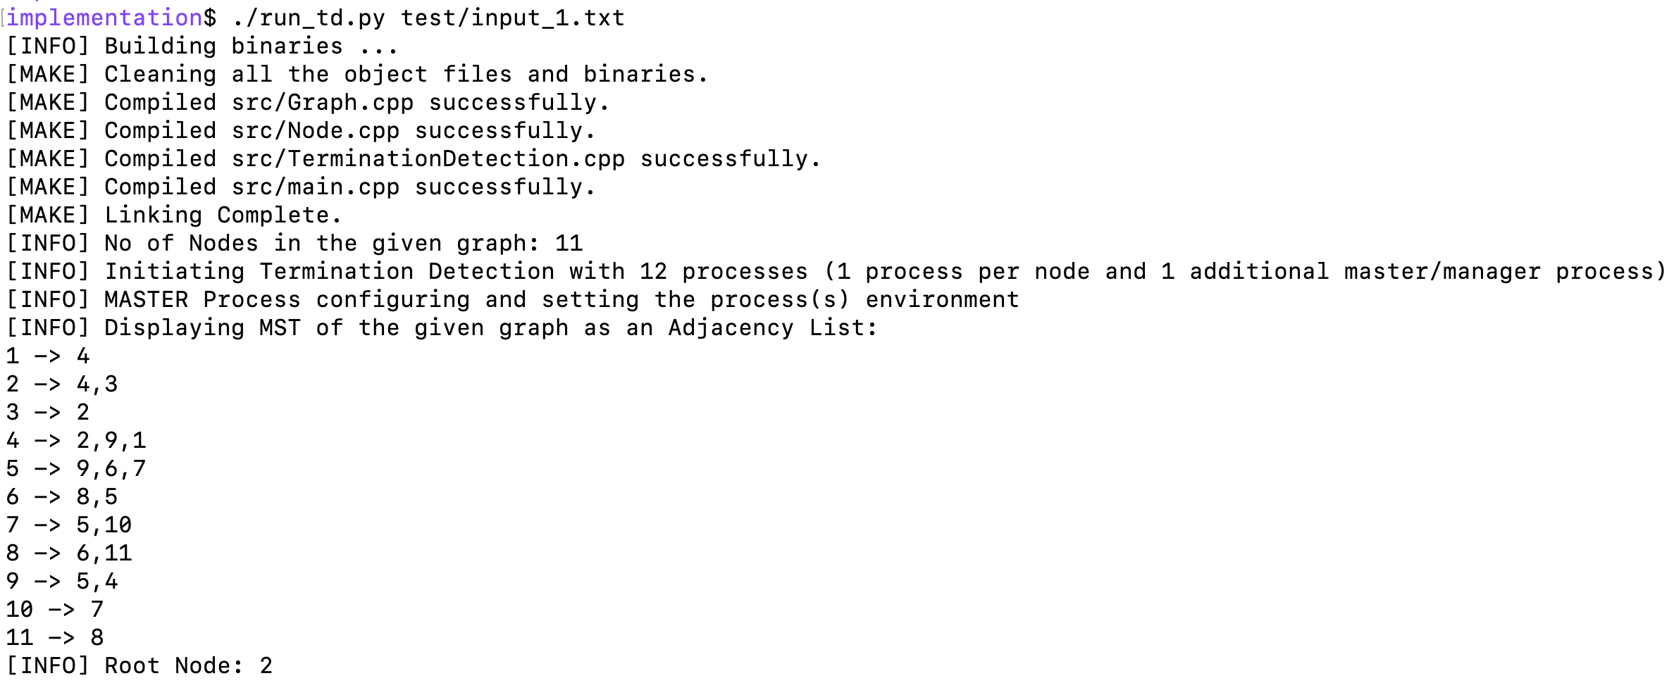
Execution Run

Slide 25
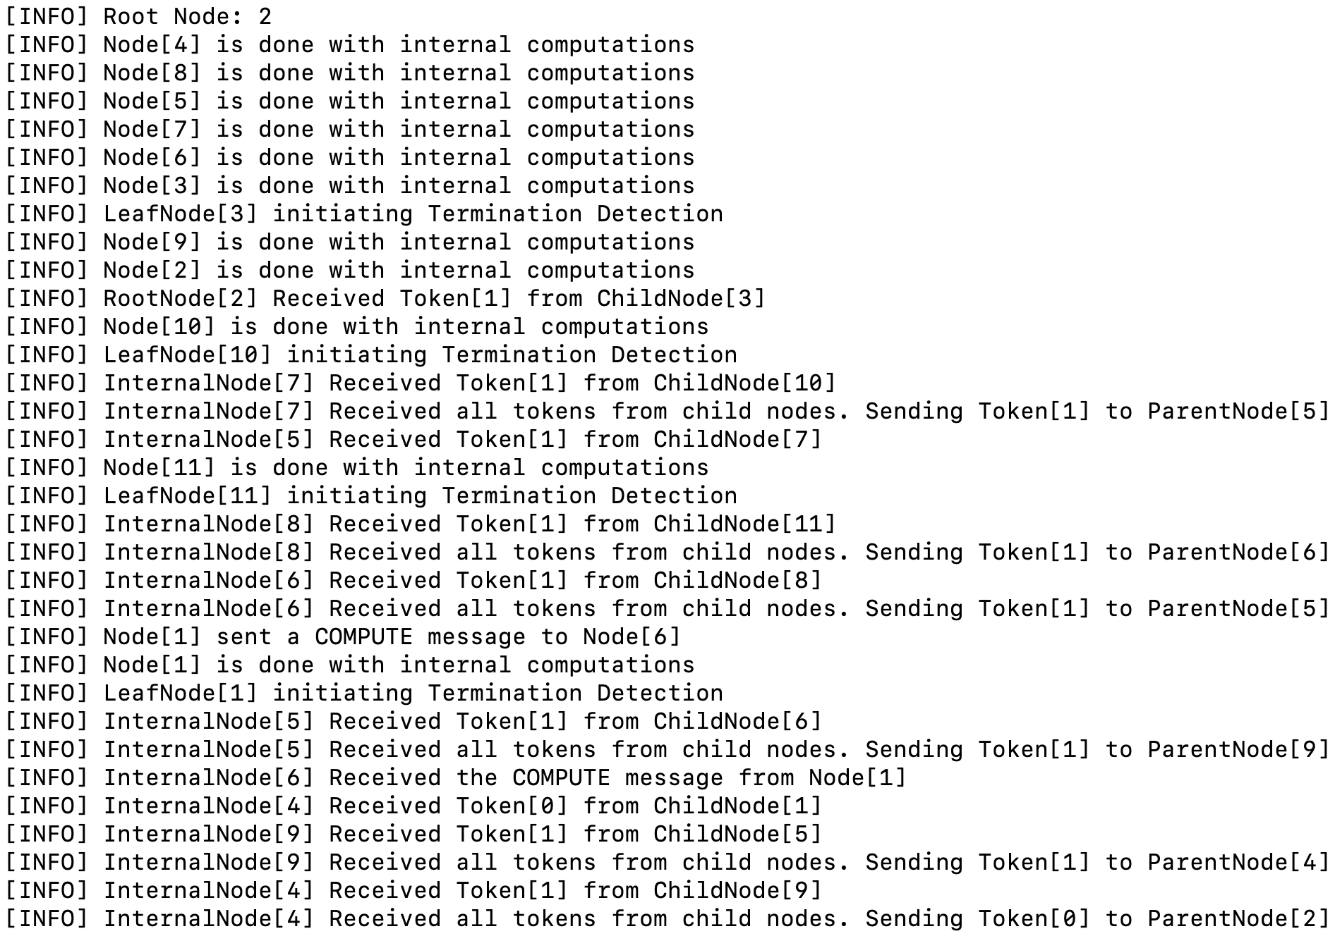
Execution Run (contd..)
COMPUTE message
sent
Node 1 sent BLACK token to Node 4
COMPUTE message
received

Slide 26
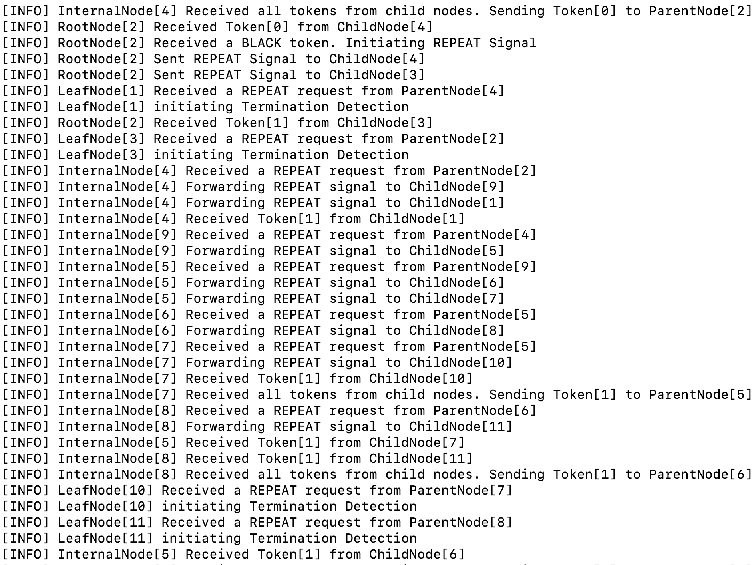
Execution Run (contd..)
Root node received BLACK token. Sending REPEAT to all child nodes
Node 1 sent WHITE token to Node 4
Leaf nodes re-initiating termination detection.

Slide 27
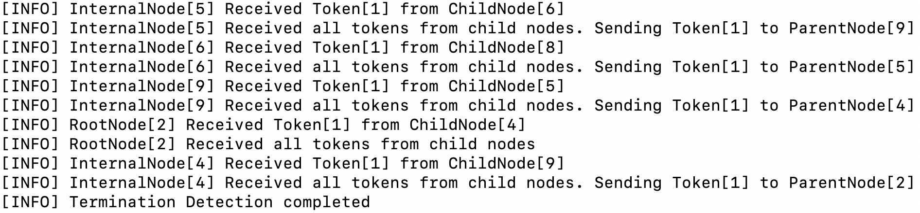
Execution Run (contd..)

Slide 28
References & Project Links
Termination Detection for Distributed Computations – Rodney.W.Topor
A Message-Optimal Algorithm for Distributed Termination Detection – S.Chandrashekharan & S.Venkatesan
An Algorithm for Solving Distributed Termination Detection – R.K.Arora & M.N.Gupta
Distributed Computing – Principles, Algorithms & Systems (Chapter 7) – Ajay D. Kshemkalyani & Mukesh Singhal
MPI The Complete Reference - Marc Snir, Steve Otto, Steven Huss Lederman, David Walker, Jack Dongarra
OpenMPI 4.1.1 Documentation - https://www.open-mpi.org/doc/current/
Project GitHub Page (will be made public after 30th April, 11:55 PM)
https://github.com/adisarip/DS_Project
Presentation Video – [TODO]

Slide 29

Thank you

